Slide 1

Transport Layer (TCP)
Lecture 5 | CSE421 – Computer Networks
Department of Computer Science and Engineering School of Data & Science

Slide 2
TCP Services
Stream delivery
Segmenting and Reassembling segments
Multiplexing segments
Full Duplex Service
Identifying and tracking the segments of different applications
Connection Oriented Service
Reliable service

Slide 3
Objectives (Part 1)
Stream delivery
Segmenting and Reassembling segments
Multiplexing segments
Full Duplex Service
Identifying and tracking the segments of different applications.

Slide 4
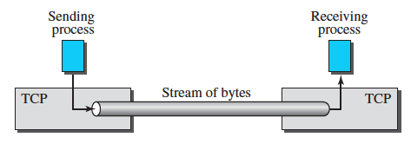
Stream Delivery
TCP, unlike UDP, is a stream-oriented protocol
TCP allows the sending process to deliver data as a stream of bytes
And allows the receiving process to obtain data as a stream of bytes

Slide 5
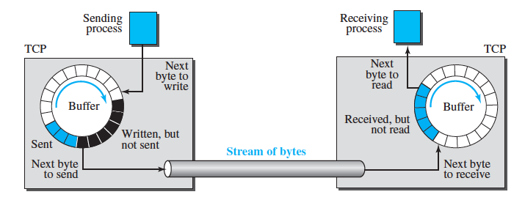
Buffers
The sending and the receiving processes may not necessarily write or read
data at the same rate
So TCP will need to store the data in a place before it can process it.
That storage space is known as buffer

Slide 6
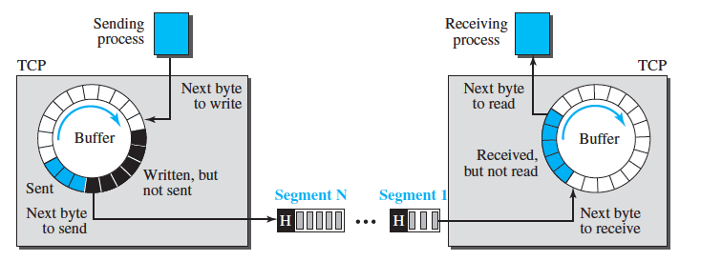
Segments
The network layer, as a service provider for TCP, needs to send data in packets, not as a stream of bytes.
So TCP groups a number of bytes together into a packet called a segment .

Slide 7
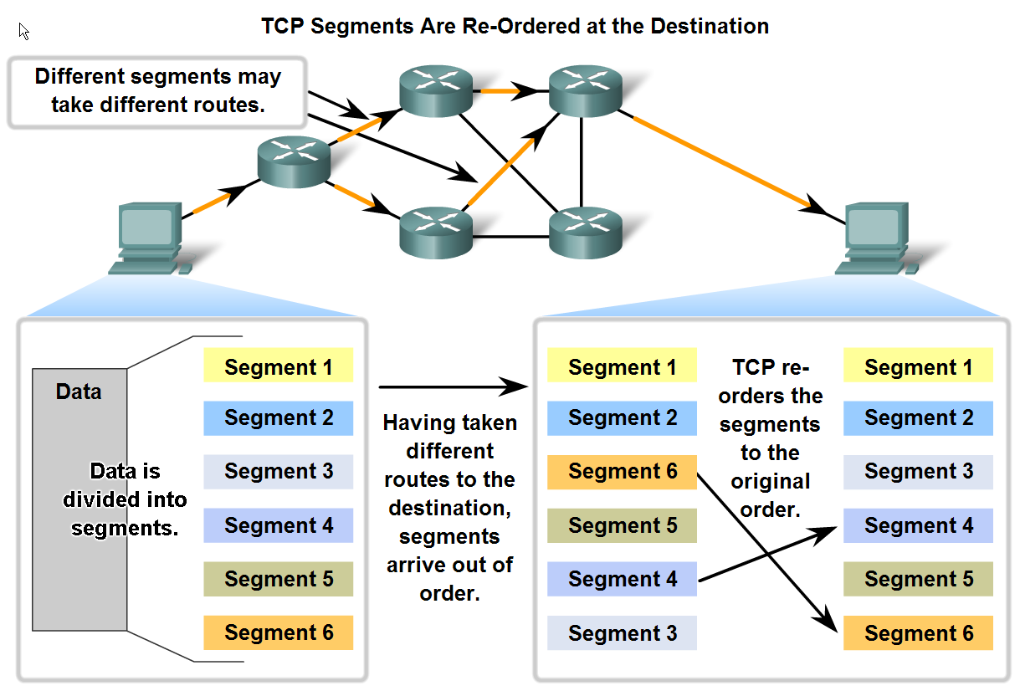
TCP Segment Reassembly

Slide 8
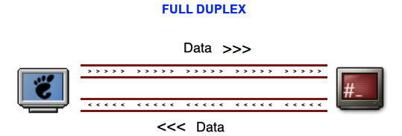
Full Duplex
Each TCP connection supports a pair of byte streams, one flowing in each direction.
Exchanging data (sending and receiving) between two entities at the same time.

Slide 9
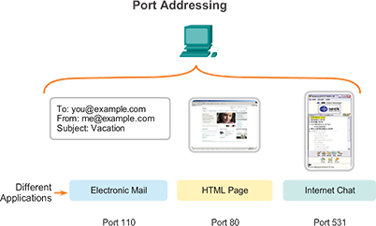
Identifying and tracking the segments
TCP and UDP-based services must keep track of the various applications communicating.
To differentiate the segments and datagrams for each application, both TCP and UDP uses port numbers.

Slide 10
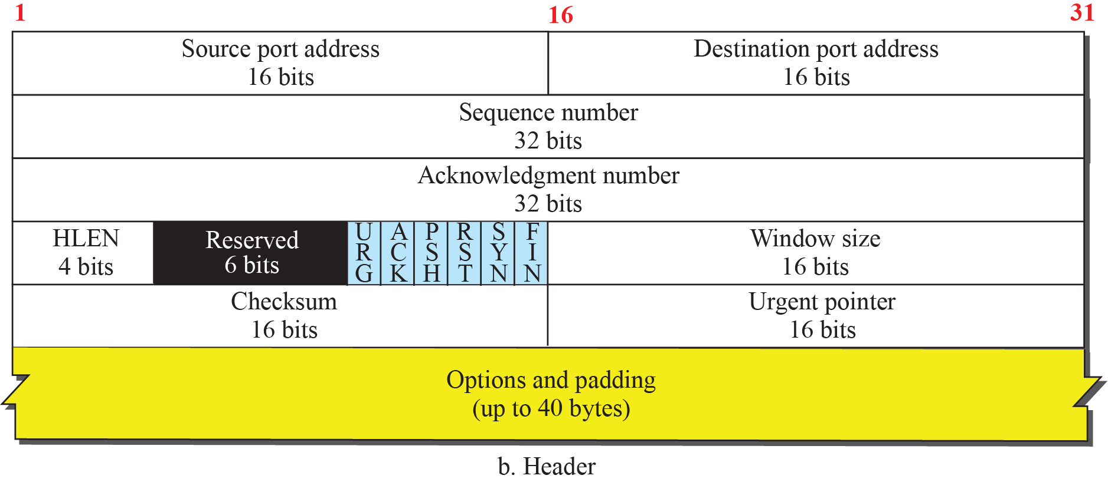
Objectives (Part 2)
TCP Segment Header
All header fields

Slide 11
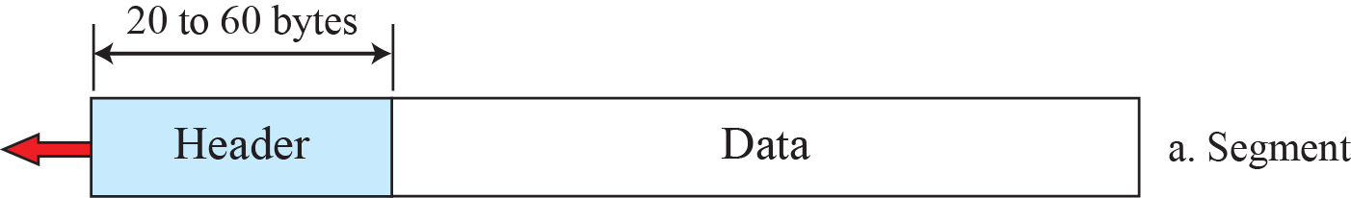
TCP Segment Header

Slide 12
Byte Number
The bytes of data being transferred in each connection are numbered by TCP.
The numbering starts with an arbitrarily generated number.
An arbitrary number between 0 and 2³² − 1 for the number of the first byte.
For example if the number of the first byte happens to be 1067 and the total data to be sent is 3000 bytes .
What is the byte number for the first byte of data and last byte of data?
First Byte Number
1067
Last Byte Number
4066

Slide 13
Sequence Numbers
The sequence number of the first segment is the ISN (initial sequence number), which is a random number (byte number).
The sequence number of any other segment is the sequence number of the previous segment plus the number of bytes (real or imaginary) carried by the previous segment.
Suppose a TCP connection is transferring a file of 5,000 bytes. The first byte is numbered 10,001. What are the sequence numbers for each segment if data are sent in five segments, each carrying 1,000 bytes?
Solution:

Slide 14
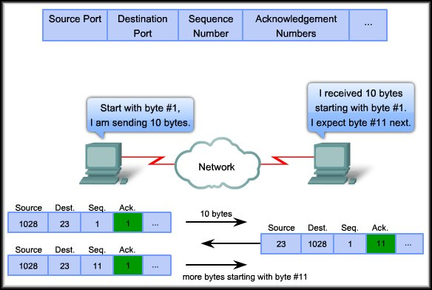
Acknowledgement Number
If receiving host TCP receives uncorrupted data, then…
It sends an acknowledgement by giving the sequence number of the byte that it expects next.
Expectational Acknowledgement

Slide 15
Acknowledgement Number
The value of the acknowledgment field in a segment defines the number of the next byte the receiver expects to receive.
The acknowledgment number is cumulative.
For example if the sender receives 1001 as the acknowledgement number.
What does it mean?
Received all data up to
1000, tells the sender that it ready to receive the next data from 1001 byte number.
Note :This does not indicate receiver has received 1000 bytes of data. Why?

Slide 16
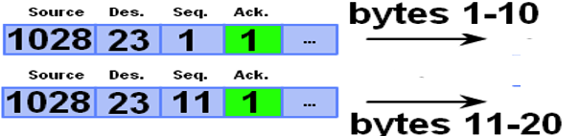

Acknowledgement Number
The acknowledgment number is cumulative.
Receiver acknowledges multiple data segments in one acknowledgement.
Sender
Receiver

Slide 17
Header Length
Header Length :
Indicates the number of 4-byte words
The length of the header can be between 20 and 60 bytes

Slide 18
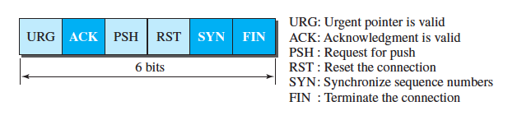
Control Bits
Control Bits:
This field defines 6 different control bits or flags
One or more of these bits can be set at a time
These bits help indicate connection establishment and termination, flow control

Slide 19
Window Size
Window Size:
This field defines size of data in bytes of the sending TCP process
The maximum size of the window is 65,535 bytes
Normally referred to as the receiving window (rwnd )
The sender must obey the dictation of the receiver in this case

Slide 20
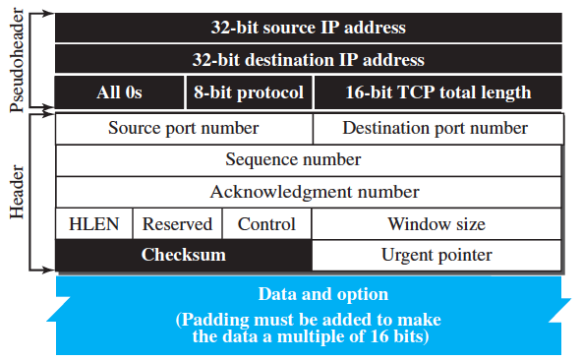
Checksum
This 16 bits field is used to check if the segment got corrupted (intentionally or unintentionally) while segment was on traveling in order to reach the destination.
Mandatory in TCP
TCP Header
TCP Body
Pseudo IP Header

Slide 21
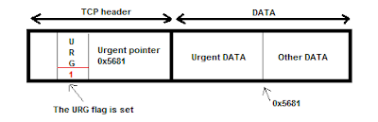

Urgent Pointer
This 16-bit field, which is valid only if the urgent flag is set.
Used when the segment contains urgent data.
It defines a value that must be added to the sequence number to obtain the number of the last urgent byte in the data section of the segment.
1500
1oo1
1500

Slide 22
Options
There can be up to 40 bytes of optional information in the TCP header
Provides a way to deal with limitations of the original header
For example :
MSS (Maximum Segment Size) is defined as the largest block of data that a sender using TCP will send to the receiver

Slide 23
Objectives (Part 3)
TCP Services
Connection Establishment
Pushing Data
Connection Termination

Slide 24
Connection Establishment
TCP sets up a connection between end hosts before sending data
This process is known as ”Three-way handshake”
After the connection is established the hosts can send data

Slide 25


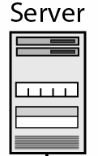
3 Way Handshake : Connection Establishment
49152
80
Source Port No. |  |  |  |  |  | Destination Port No.
Sequence No.
Acknowledgement No.
 | U | A | P | R | S | F | Window Size
Others
 |  |  |  |  |  |  | Window Size
Others
49152
49152
80
80
49152
80
100
0
101
0
101
1
A
A
S
S

Slide 26
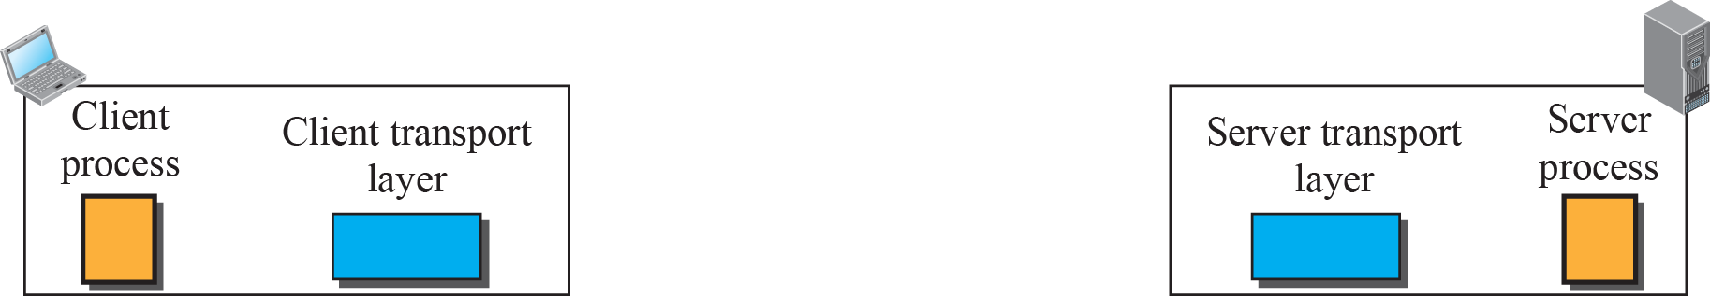
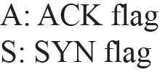
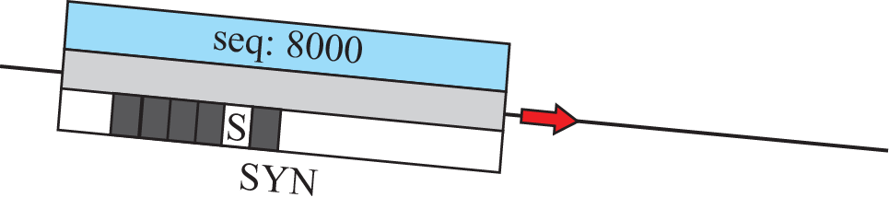


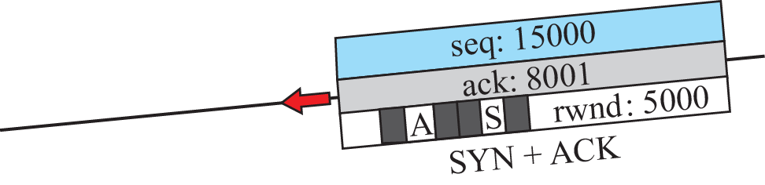
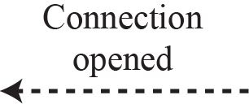
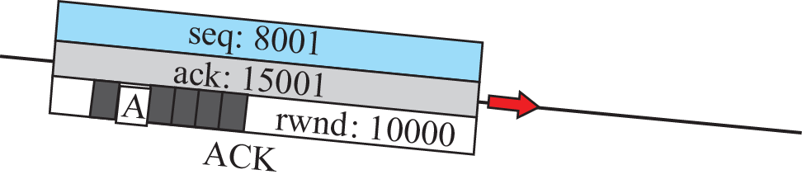
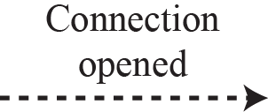

3 Way Handshake : Connection Establishment

Slide 27




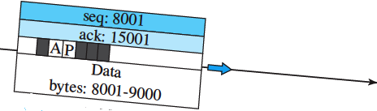
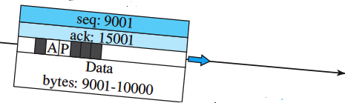
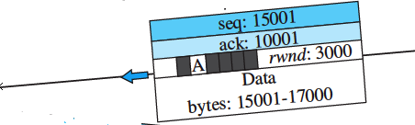
Data Transfer

Slide 28
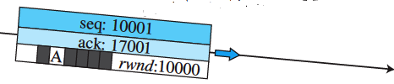

Data Transfer Continued..

Slide 29
Connection Termination

Slide 30
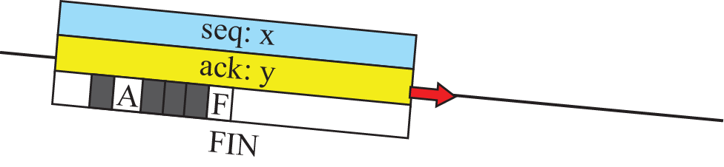

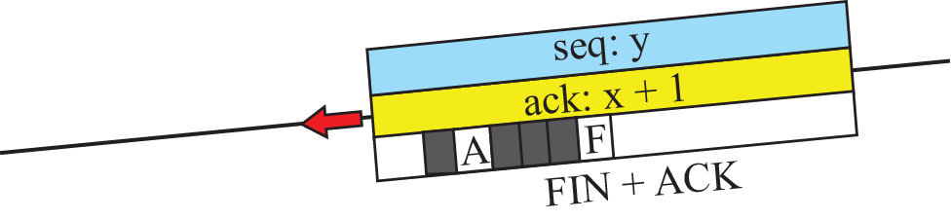
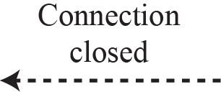

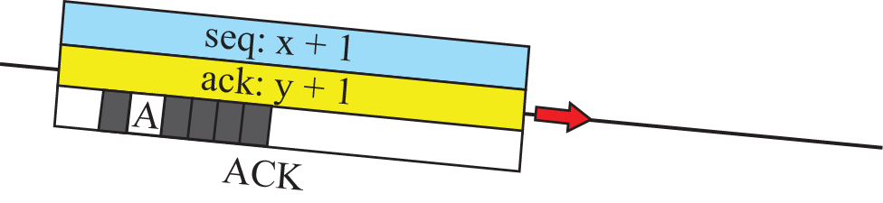
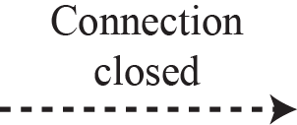
3 Way Handshake : Connection Termination

Slide 31
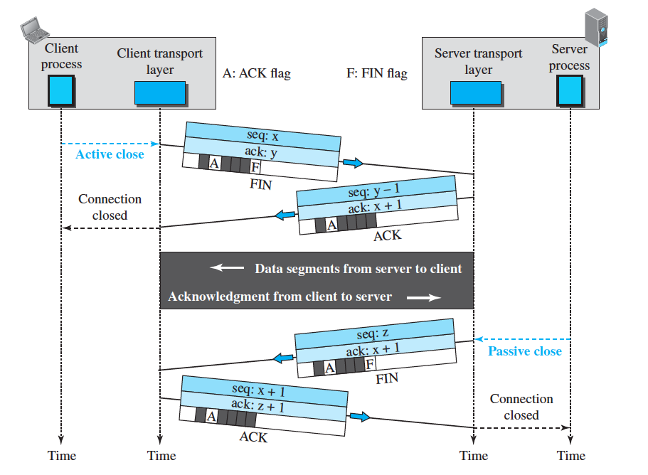
Connection Termination :: Half Close

Slide 32
Objectives (Part 4)
Reliable service
Error Control

Slide 33
Reliability in TCP
TCP provides reliability using error control
Error control includes mechanisms for
detecting and resending corrupted segments
resending lost segments
storing out-of order segments until missing segments arrive
detecting and discarding duplicated segments.
Error control in TCP is achieved through
Checksum
Acknowledgment
Time-out and retransmission

Slide 34
Error Control
Checksum
Each segment includes a checksum field, which is used to check for a corrupted segment
If a segment is corrupted, as detected by an invalid checksum, the segment is discarded
Acknowledgment
To confirm the receipt of data segments.
To confirm control segments that carry no data, but consume a sequence number
ACK segments do not consume sequence numbers and are not acknowledged.

Slide 35
Types and Rules of Acknowledgment
Cumulative Acknowledgment (ACK)
Selective Acknowledgment (SACK)
Generating Acknowledgments Rules (1 to 3)
Rule 1: When host A sends a data segment to host B, it must include (piggyback) an acknowledgment number.
Rule 2 : The receiver needs to delay sending an ACK segment if there is only one outstanding in-order segment.
Rule 3: When a segment arrives with a sequence number that is expected by the receiver, and the previous in-order segment has not been acknowledged, the receiver immediately sends an ACK segment.

Slide 36
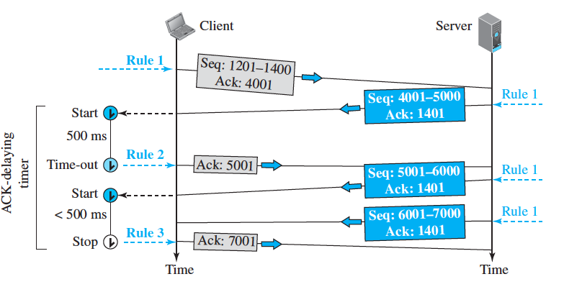
Normal Operation
Add Ack No always
Delay Ack, if only one segment.
If prev segment received not ack’ed then send Ack .

Slide 37
Other Scenarios
Segment Lost or Corrupted?
Retransmission of segment ??
How will the sender know ??
What about the receiver, not aware of a packet sent?
Retransmission after time out.

Slide 38
Retransmission
The heart of the error control mechanism is the retransmission of segment
When a segment is sent, it is stored in a queue until it is acknowledged.
Retransmission of segment will occur
After RTO
The sending TCP maintains one retransmission time-out (RTO) for each connection.
When the timer matures TCP resends the segment in the front of the queue
After Three Duplicate ACK Segments
If three duplicate acknowledgments (i.e., an original ACK plus three exactly identical copies) arrive for a segment, the next segment is retransmitted without waiting for the time-out.

Slide 39
Out of Order Segments
TCP implementations today do not discard out-of-order segments.
They store them temporarily .
Flag them as out-of-order segments until the missing segments arrive.
Out-of-order segments are never delivered to the process.
TCP guarantees that data are delivered to the process in order.

Slide 40
Rules of Acknowledgment contd
Generating Acknowledgments Rules (4 to 6)
Rule 4: When a segment arrives with an out-of-order higher sequence number the receiver immediately sends an ACK segment .
Rule 5 : When a missing segment arrives, the receiver sends an ACK segment to announce the next sequence number expected.
Rule 6: If a duplicate segment arrives, the receiver discards the segment, but immediately sends an acknowledgment indicating the next in-order segment expected.

Slide 41
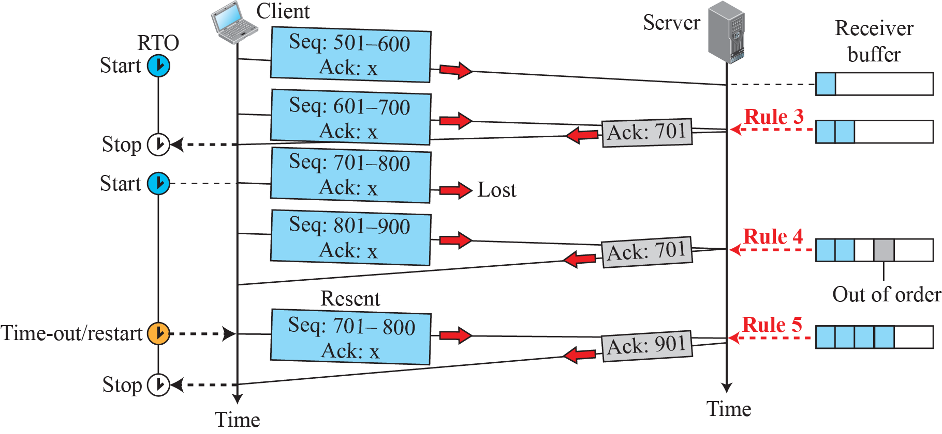
Lost Segment
If prev segment received not ack’ed then send Ack .
If segment received out of order then send Ack .
As soon as missing segment received then send Ack .

Slide 42
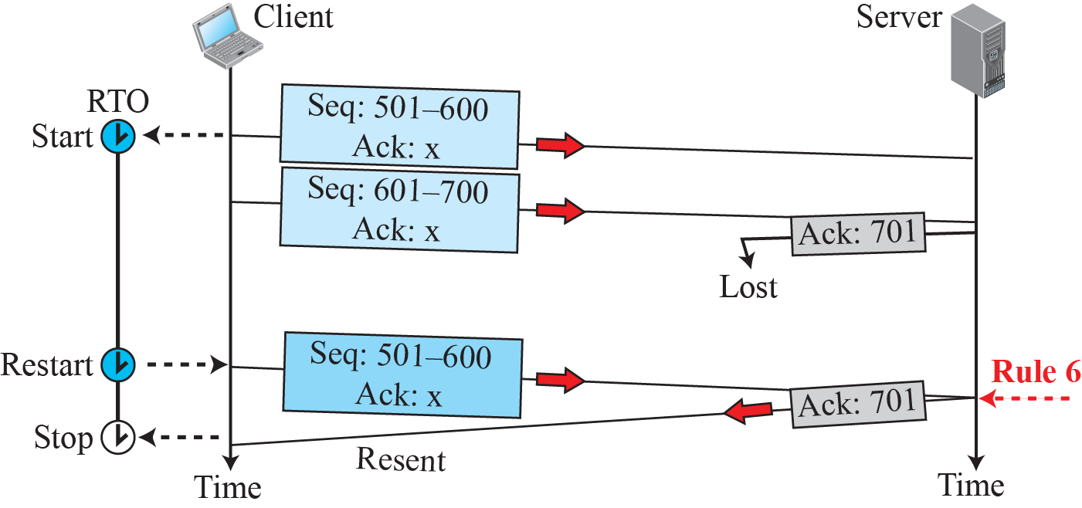
Lost Ack corrected by resending a segment
If duplicate segment arrives then send Ack .

Slide 43
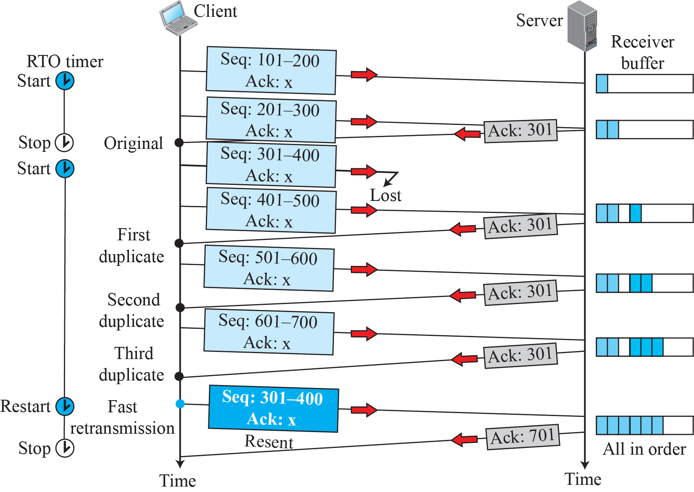
Fast Retransmission :: 3 Acks

Slide 44
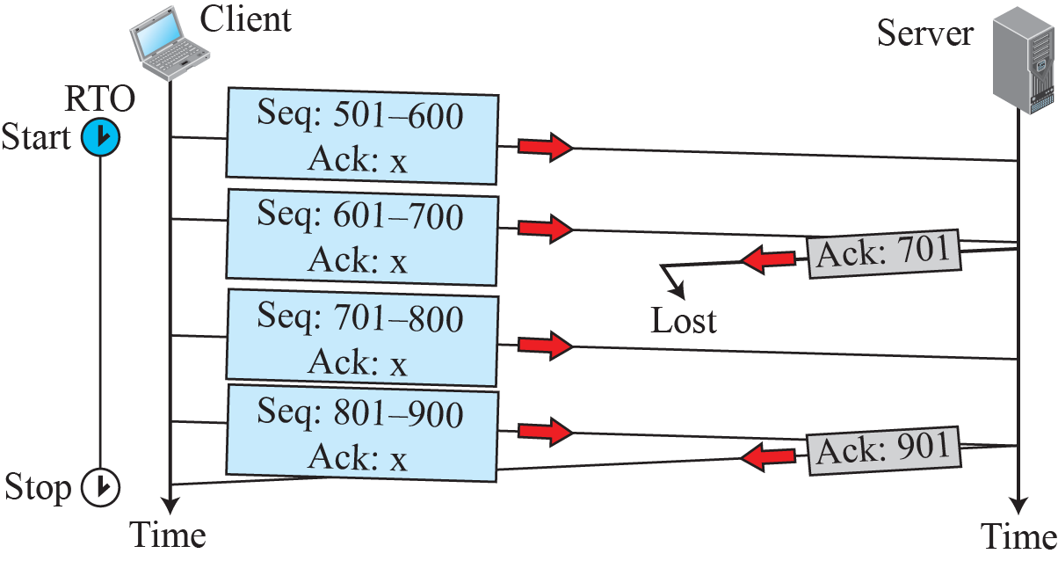
Lost Acknowledgement

Slide 45
Objectives (Part 5)
Reliable service
Flow Control
Sliding Window Concept

Slide 46
Flow Control
Transmission Control Protocol (TCP) uses a sliding window for flow control.
What is the “Window ”?
Indicates the size of the device's receive buffer for the particular connection.
How much data a device can handle from its peer at one time before it is passed to the application process.
Set by receiver of data
Example : The server's window size was 360. This means the receiver is willing to take no more than 360 bytes at a time from the sender.

Slide 47
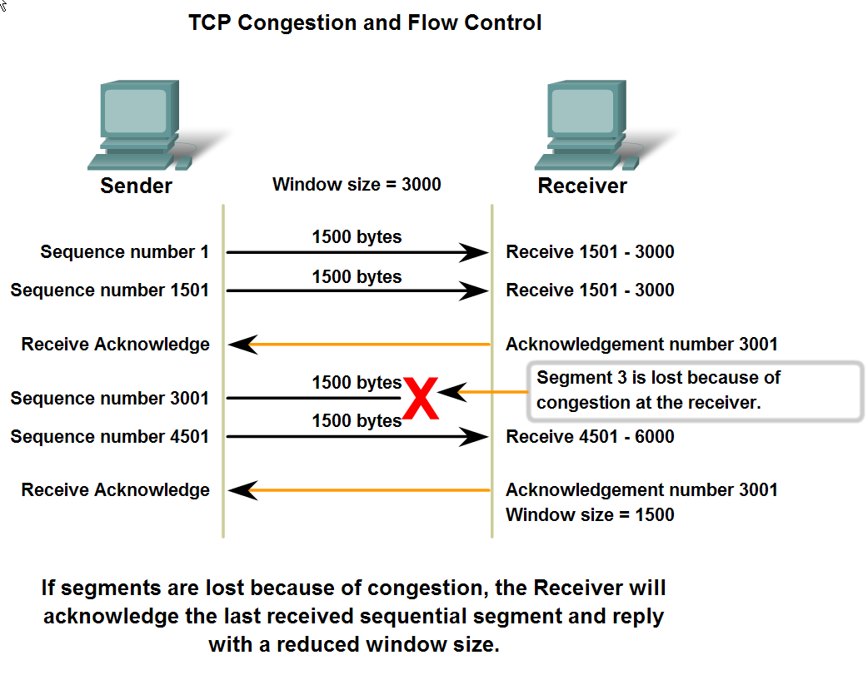
Flow Control

Slide 48
Sender Sliding Window
Window Size = 100 bytes
First outstanding byte
Next byte to send
S_{f}
S_{n}
. . . |  |  | . . . . . |  |  | . . . . . |  |  | . . .
Bytes that are acknowledged
Outstanding Bytes
sent but not acknowledged
Bytes that can be sent (Usable window)
Bytes that cannot be sent
Window Size as advertised by the receiver

Slide 49
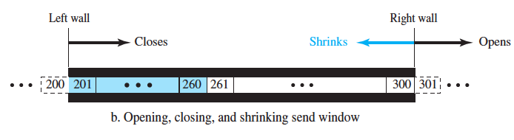
Sliding of Sender Window

Slide 50
Sliding of Sender Window
#Sender receives a segment with ACK 241
And rwnd = 60
rwnd = 100
Window Size = 100 bytes
First outstanding byte
First outstanding byte
Next byte to send
Variables
Sf = 201
Sn = 261
Variables
Sf = 241
Sn = 261
S_{f}
S_{f}
S_{n}
. . . | 200 | 201 | . . . | 241 | 242 | . . . | 260 | 261 | . . . . . | 300 | 301 | . . .
340
Outstanding Bytes
sent but not acknowledged
Bytes that cannot be sent
Bytes that are acknowledged
Bytes that are acknowledged
Outstanding Bytes
sent but not acknowledged
Bytes that can be sent (Usable window)
Window Size as advertised by the receiver

Slide 51
Receiver Sliding Window
Window Size = 100 bytes
Next byte to be pulled by process
Next byte expected to receive
R_{n}
. . . | 200 | 201 | . . . . . | 260 | 261 | . . . . . | 300 | 301 | . . .
Bytes that have already been pulled by the process
Bytes received and acknowledged, waiting to be consumed by process
Bytes that can be received from the sender
Receive window(rwnd)
Bytes that cannot be received
Receive window and allocated buffer
rwnd= buffer size – number of bytes to be pulled
= 40 bytes

Slide 52
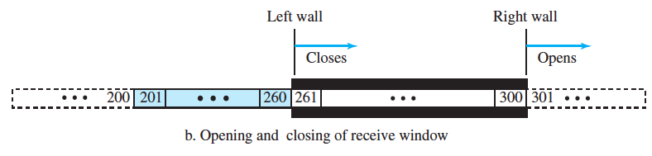
Sliding of Receiver Window

Slide 53










Flow Control Example

Slide 54





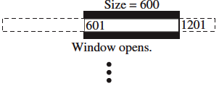



Flow Control Example Contd

Slide 55
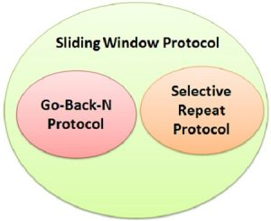
Different TCP Sliding Window Protocols
Go Back N Protocol
If the sent segment are are found corrupted or lost then all the segments are re-transmitted from the lost segment to the last segment transmitted
Do not keep track of out of order segments
Efficient for less noisy channel

Slide 56
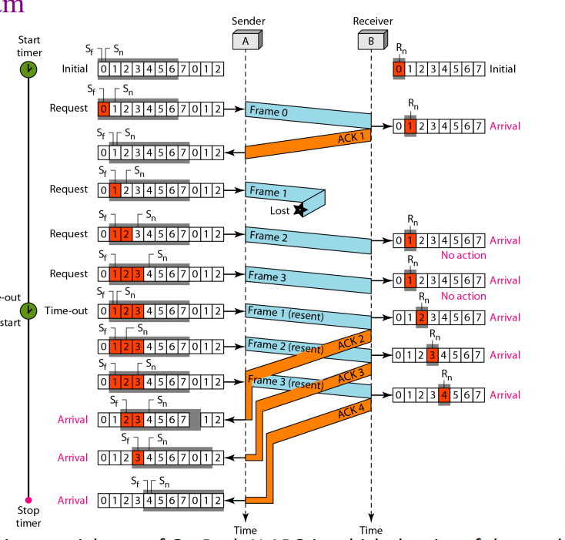
Go Back N ARQ

Slide 57
Different TCP Sliding Window Protocols
Selective Repeat Protocol
Only those segments are re-transmitted which are found lost or corrupted
Keep track of out of order segments at the receiver side
More efficient for noisy channels
Widely used in TCP

Slide 58
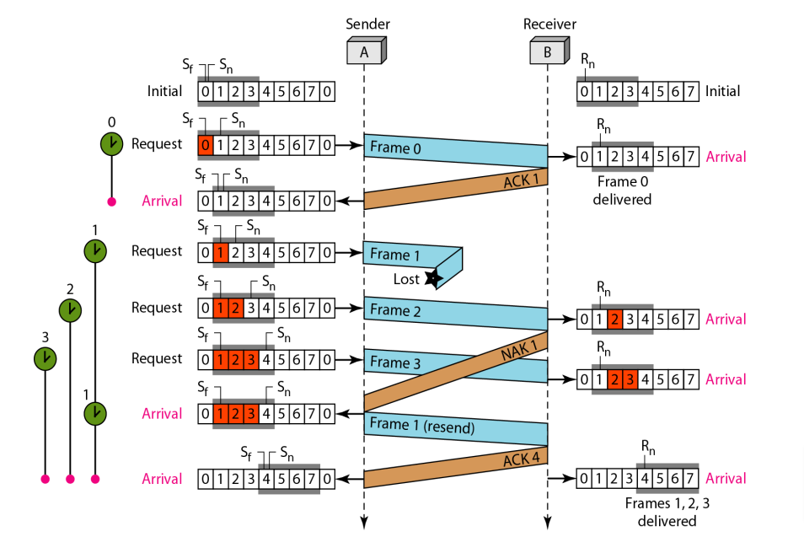
Selective Repeat ARQ

Slide 59
Overall Flow control
The initial window size is agreed during the three-way handshake.
If this is too much for the receiver and it loses data (e.g. buffer overflow) then it can decrease the window size.
If all is well then the receiver will increase the window size.

Slide 60
The End

